Slide 1



Slide 2




Artificial Intelligence (CS-401) Introduction to Machine Learning
Dr. Fahad Sherwani (Assistant Professor – FAST NUCES)
PhD in Artificial Intelligence
Universiti Tun Hussein Onn Malaysia
fahad.sherwani@nu.edu.pk

Slide 3
Outline
Overview about Machine Learning and its paradigms and applications
Introduction and Motivation
Challenges of Machine Learning
Learning Types
Supervised Learning
Unsupervised Learning
Reinforcement Learning
Real World Examples

Slide 4
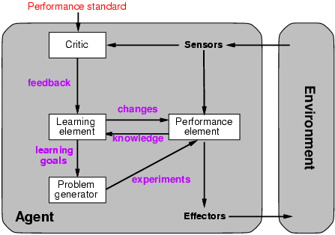
Learning Agents
The agent adapts its action(s) based on feedback (not only sensors).

Slide 5
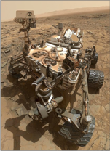
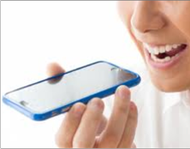
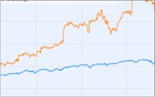
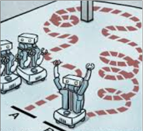
Introduction
What is Machine Learning?
Field of study that gives computers the ability to learn without being explicitly programmed (Arthur Samuel 1959)
Why is Machine Learning needed?
Machine Learning is used when:
Human expertise does not exist. (Curiosity Rover).
Humans are incapable of explaining their expertise(Speech Recognition).
Amount of data is too large for a human to analyze (Data Mining).
Prediction of new data (Stock Market Prediction).
Tasks that are learnt by practicing (Robot Path Planning).
5

Slide 6
Motivation: Inductive Learning
Simplest form: learn a function from examples
f is the target function
An example is a pair (x, f(x))
Problem: find a hypothesis h
such that h ≈ f
given a training set of examples
This is a highly simplified model of real learning:
Ignores prior knowledge
Assumes examples are given

Slide 7
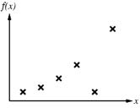
Motivation: Inductive Learning
Construct/adjust h to agree with f on training set (h is consistent if it agrees with f on all examples)
E.g., curve fitting:

Slide 8
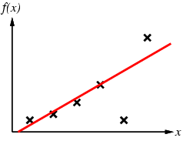
Motivation: Inductive Learning
Construct/adjust h to agree with f on training set (h is consistent if it agrees with f on all examples)
E.g., curve fitting:

Slide 9
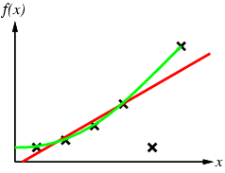
Motivation: Inductive Learning
Construct/adjust h to agree with f on training set (h is consistent if it agrees with f on all examples)
E.g., curve fitting:

Slide 10
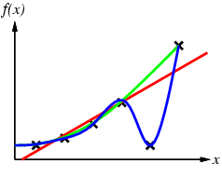
Motivation: Inductive Learning
Construct/adjust h to agree with f on training set (h is consistent if it agrees with f on all examples)
E.g., curve fitting:

Slide 11
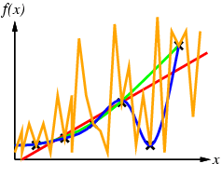
Motivation: Inductive Learning
Construct/adjust h to agree with f on training set (h is consistent if it agrees with f on all examples)
E.g., curve fitting:

Slide 12
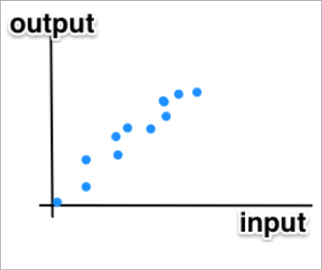
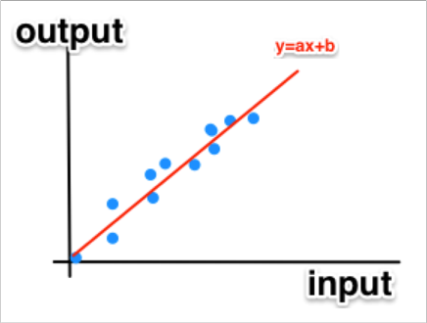
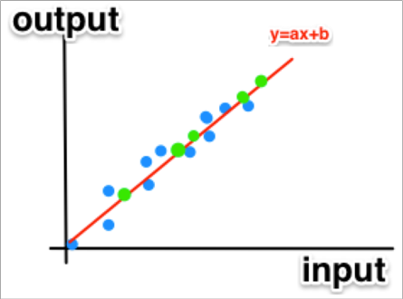




Introduction to Machine Learning
What is meant by learning?
Writing algorithms that can learn patterns from data.
The algorithms create a statistical model that is a good approximation of the data.
Data from Past Experiences
Calculating a model
Estimating the output for new input values

Slide 13
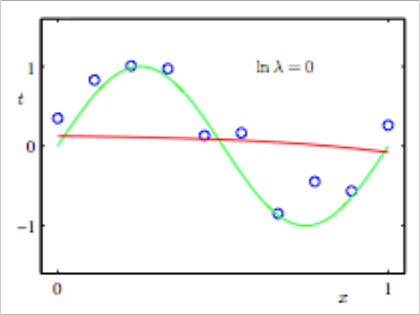
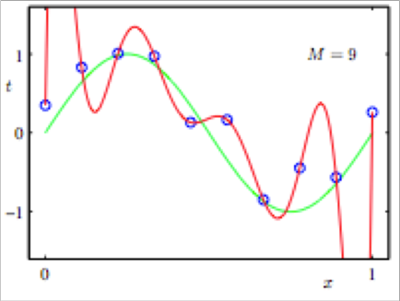
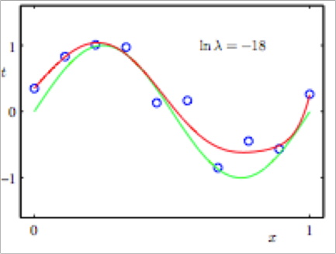
Challenges of Machine Learning
High Dimensionality
Complexity of the data becomes very high and requires bigger models
Requires a greater amount of memory and more time to process.
Might cause over-fitting.
Example: DNA Microarray
Choice of Statistical Model
Choosing the correct model and parameters that satisfy the available data can cause under-fitting or over-fitting

Slide 14
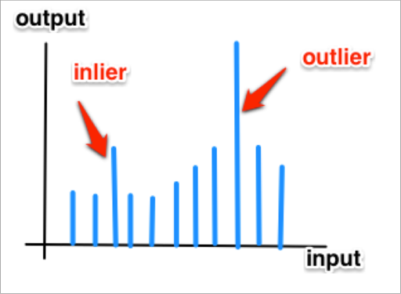
Challenges of Machine Learning
Noise and Errors [5]
Gaussian Noise: Statistical Noise that has its probability density function equal to normal distribution.
Outlier: an observation that is distant from the rest of the data.
Inlier: a local outlier. (see: 2-sigma rule).
Human Error causing incorrect measurements

Slide 15
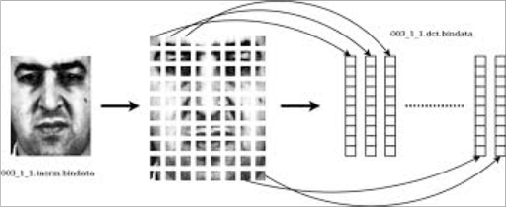
Challenges of Machine Learning
Insufficient Training Data
The amount of data is not sufficient to build a good approximation of the process that generated the data.
Feature Extraction in Patterns
Feature extraction is the process of converting the data to a reduced representation of a set of features.
Image Reference: Face Verification

Slide 16
Learning Types
Supervised Learning
Unsupervised Learning
Reinforcement Learning
Other Learning Paradigms

Slide 17
Supervised Learning
Training data contains examples of the input vectors along with their corresponding target/output vectors.
Definition of training data: {(x₁,y₁), (x₂ ,y₂).., (x_{n} , y_{n})}
Goal: Find a model that predicts output y for an input x
Can be divided to two categories: Regression and Classification

Slide 18
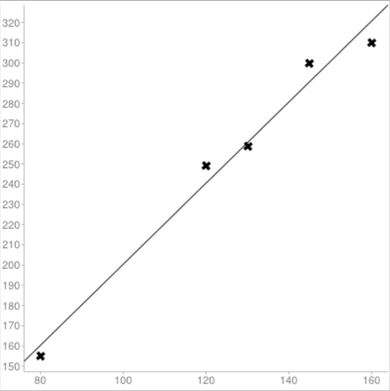
Supervised Learning
Regression:
Regression aims to estimate a response.
The output y takes numeric values.
Toy Problem: We have a data of apartments with their areas and prices. We want to find a model that describe it and predict the prices of other areas (Assuming that all other variables don’t have any effect).
Example of Training Data:
Area (m²) | Price (1000$)
80 | 155
120 | 249
130 | 259
145 | 300
160 | 310
A = 2.005
B = -0.0557

Slide 19
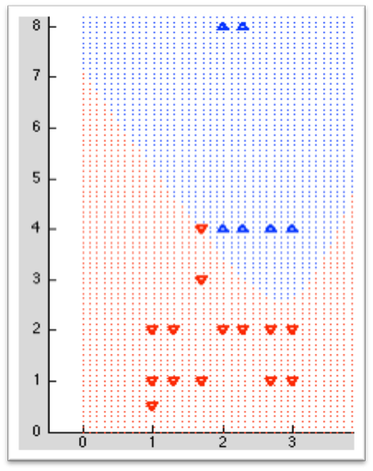
Supervised Learning
Classification:
Classification aims to identify group membership.
The output y takes class labels.
Toy Problem: We want to determine whether a Computer is good or not from the processor and available memory
Example of Training Data:
Processor (GHz) | Memory (GB) | Status
1.0 | 1.0 | Bad
2.3 | 4.0 | Good
2.6 | 4.0 | Good
3.0 | 8.0 | Good
2.0 | 4.0 | Bad
2.6 | 0.5 | Bad

Slide 20
Unsupervised Learning
Training data contain only the input vectors
Definition of training data: {x₁, x₂ ,..., x_{n} }
Goal: Learn some structures in the inputs
Can be divided to two categories: Clustering and
Dimensionality Reduction

Slide 21
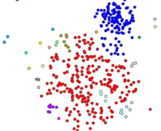
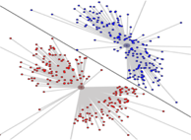
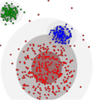
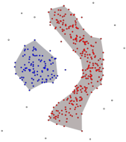
Unsupervised Learning
Clustering
Clustering aims to group input based on the similarities.
Types of clustering:
Connectivity based clustering
objects related to nearby objects than to objects farther away
Centroid based clustering
Cluster points according to a set of given centers
Distribution based clustering
objects belonging most likely to the same distribution
Density based clustering
areas of higher density than the remainder of the data set

Slide 22
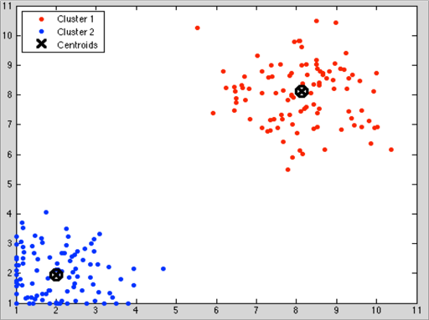
Unsupervised Learning
Clustering
Toy Example: A survey that has the following questions on a scale 1-10:
How much do you like shopping?
How much are you willing to spend on shopping?
Cluster 1 can refer to people who are addicted to shopping
Cluster 2 can refer to people who rarely go shopping

Slide 23
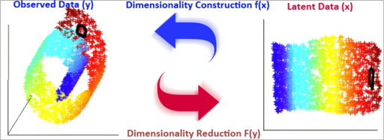
Unsupervised Learning
Dimensionality Reduction [7]
Convert high dimensional data to lower order dimension
Motivation:
High Dimensional Data Analysis
Visualization of high-dimensional data
Feature Extraction

Slide 24
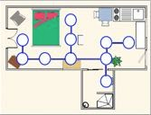
Reinforcement Learning
Learning a policy: a sequence of outputs.
Delayed reward instead of supervised output.
Toy Example: A robot wants to move from the outer door of an apartment to the bathroom to clean it.

Slide 25
Reinforcement Learning
All weights are equal at the first try. Choice of next state is randomly chosen if the weights are equal

Slide 26
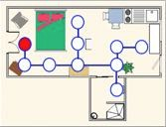
Reinforcement Learning

Slide 27
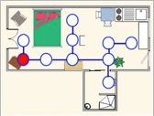
Reinforcement Learning

Slide 28
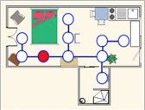
Reinforcement Learning

Slide 29
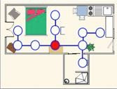
Reinforcement Learning

Slide 30
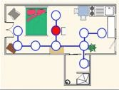
Reinforcement Learning
Left is chosen randomly since the weights are equal

Slide 31
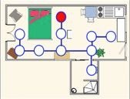
Reinforcement Learning
Wrong Destination. Return by backtracking

Slide 32
Reinforcement Learning

Slide 33
Reinforcement Learning

Slide 34
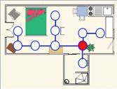
Reinforcement Learning

Slide 35
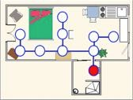
Reinforcement Learning
Reached the destination. Give a reward to the chosen paths by increasing the weight.

Slide 36
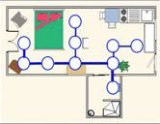
Reinforcement Learning
Adjusted weights after reinforcement learning.

Slide 37
Real World Examples
Machine Learning in Real-World Examples: [6]
Spam Filter
Signature Recognition
Credit Card Fraud Detection
Face Recognition
Text Recognition
Speech Recognition
Speaker Recognition
Weather Prediction
Stock Market Analysis
Advertisement Targeting
Language Translation
Recommendation Systems
Classifying DNA Sequences
Automatic vehicle Navigation
Object Detection
Medical Diagnosis

Slide 38
Online Courses and Material
Interactive Course with Stanford University Professor
Website: https://www.coursera.org/course/ml
Stanford University Class
Playlist: http://www.youtube.com/view_play_list?p=A89DCFA6ADACE599
Material: http://cs229.stanford.edu/

